Slide 1
Harvard University Herbarium Handwriting Transcription
Shubhangi Jain

Slide 2
Objective
To transcribe handwritten text on images of herbarium specimens.
Herbarium specimens are pressed plant samples stored on paper.
Each specimen contains a label that contains the name of the curator, their institution, the species and genus, and the collection date.
A sizable number of these labels are handwritten and date back to the early 1900s.

Slide 3
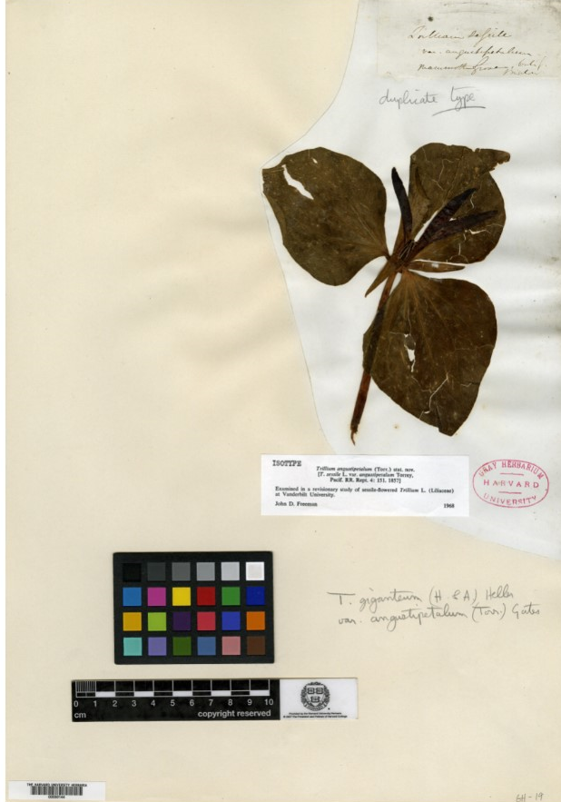
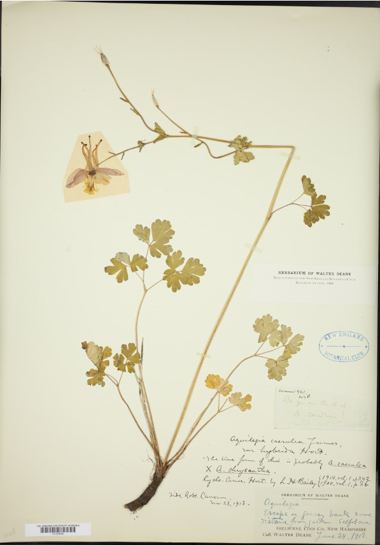

Slide 4
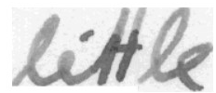
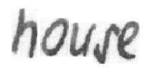


Slide 5
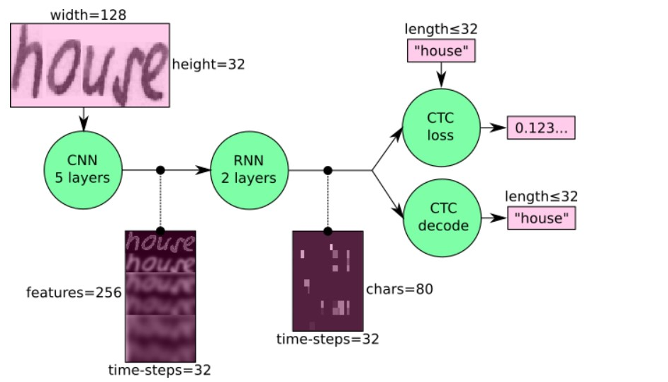

Slide 6
“little” “house” “filled”

Slide 7
Thank you!

